Slide 1
Copyright & Fair Use
with Scenarios for Illustrations and Photographs
By Shanyon Storey
ITEC 7445: Summer 2014

Slide 2
Copyright
“The exclusive right to make copies, license, and otherwise exploit a literary, musical, or artistic work, whether printed, audio, video, etc.”
http://dictionary.reference.com/browse/Copyright

Slide 3
Copyright cont.
“Works granted such right by law on or after January 1, 1978, are protected for the lifetime of the author or creator and for a period of 50 years after his or her death”
http://dictionary.reference.com/browse/Copyright

Slide 4
Fair Use
“The conditions under which you can use material that is copyrighted by someone else without paying royalties”
http://dictionary.reference.com/browse/fair+use?s=t

Slide 5

A Copyright will protect:
the author or creator from the moment the work is published
the author or creator without a formal registration for protection
most fixed work in a variety of formats

Slide 6
A copyright will not protect:
factual information or ideas
names, phrases, slogans, or titles
Works produced by the U.S. Government (but works produced by state and local governments are protected)

Slide 7
Four Factors of fair use
Purpose
Nature
Amount
Effect

Slide 8
Fair Use: Factor # 1
How is the copyrighted work used (purpose)?
Use is allowed for different reasons.
Teachers and students are protected, but there are restrictions.

Slide 9

Fair Use: Factor # 2
What is the nature of the copyrighted work?
Use includes creative works, factual information, and published works.

Slide 10

Fair Use: Factor # 3
What amount of the copyrighted work is used?
Use is allowed in small and/ or limited quantities

Slide 11
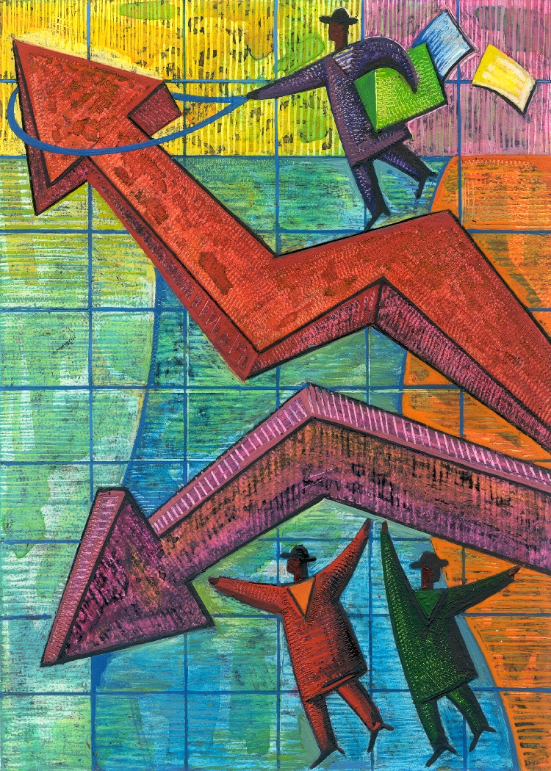
Fair Use: Factor # 4
How does the use of the copyrighted work effect the market?
Use of the work is allowed, but it cannot cause the copyright holder to lose money.

Slide 12
scenario # 1:
Using Illustrations
You are an elementary art teacher and you want to have an art show. To get the students ready, you display reproductions of illustrations from the students’ favorite books.
Is there a limit to the number of illustrations (images) that you can display?

Slide 13
Solution
Yes; no more than five images by the same illustrator (or artist) are allowed under the copyright and fair use guidelines; however a single work in its entirety is allow.
Consider using images by multiple artists.
www.techlearning.co

Slide 14
Scenario # 2:
Using Photographs
You are a student in charge of taking photos at the school fair. You do not have a portfolio of your own, so you collect photographs by a particular artist from the internet to decorate the photo booth.
Is there a limit to the number of photographs by this artist that you can display?

Slide 15
Solution
Yes; No more than five images by the same photographer are allowed under the copyright and fair use guidelines; however a single work in its entirety is allow.
Consider using images by multiple artists.
www.techlearning.co

Slide 16
Scenario # 3:
A Collection of images
You teach Art History and you want to use the complete works of art by the top artist in the specific genre that you are covering. The artists’ work includes seventy-five images.
How many images can you use according to the copyright and fair use guidelines?

Slide 17
Solution
Only 15 images or 10% of a collection (whichever is fewer) are allowed according to the copyright and fair use guidelines
ww.techlearning.com

Slide 18
For more information
http://fairuse.stanford.edu/
http://www.copyright.com/Services/copyrightoncampus/basics/
www.techlearning.com
www.halldavidson.net.

